Slide 1


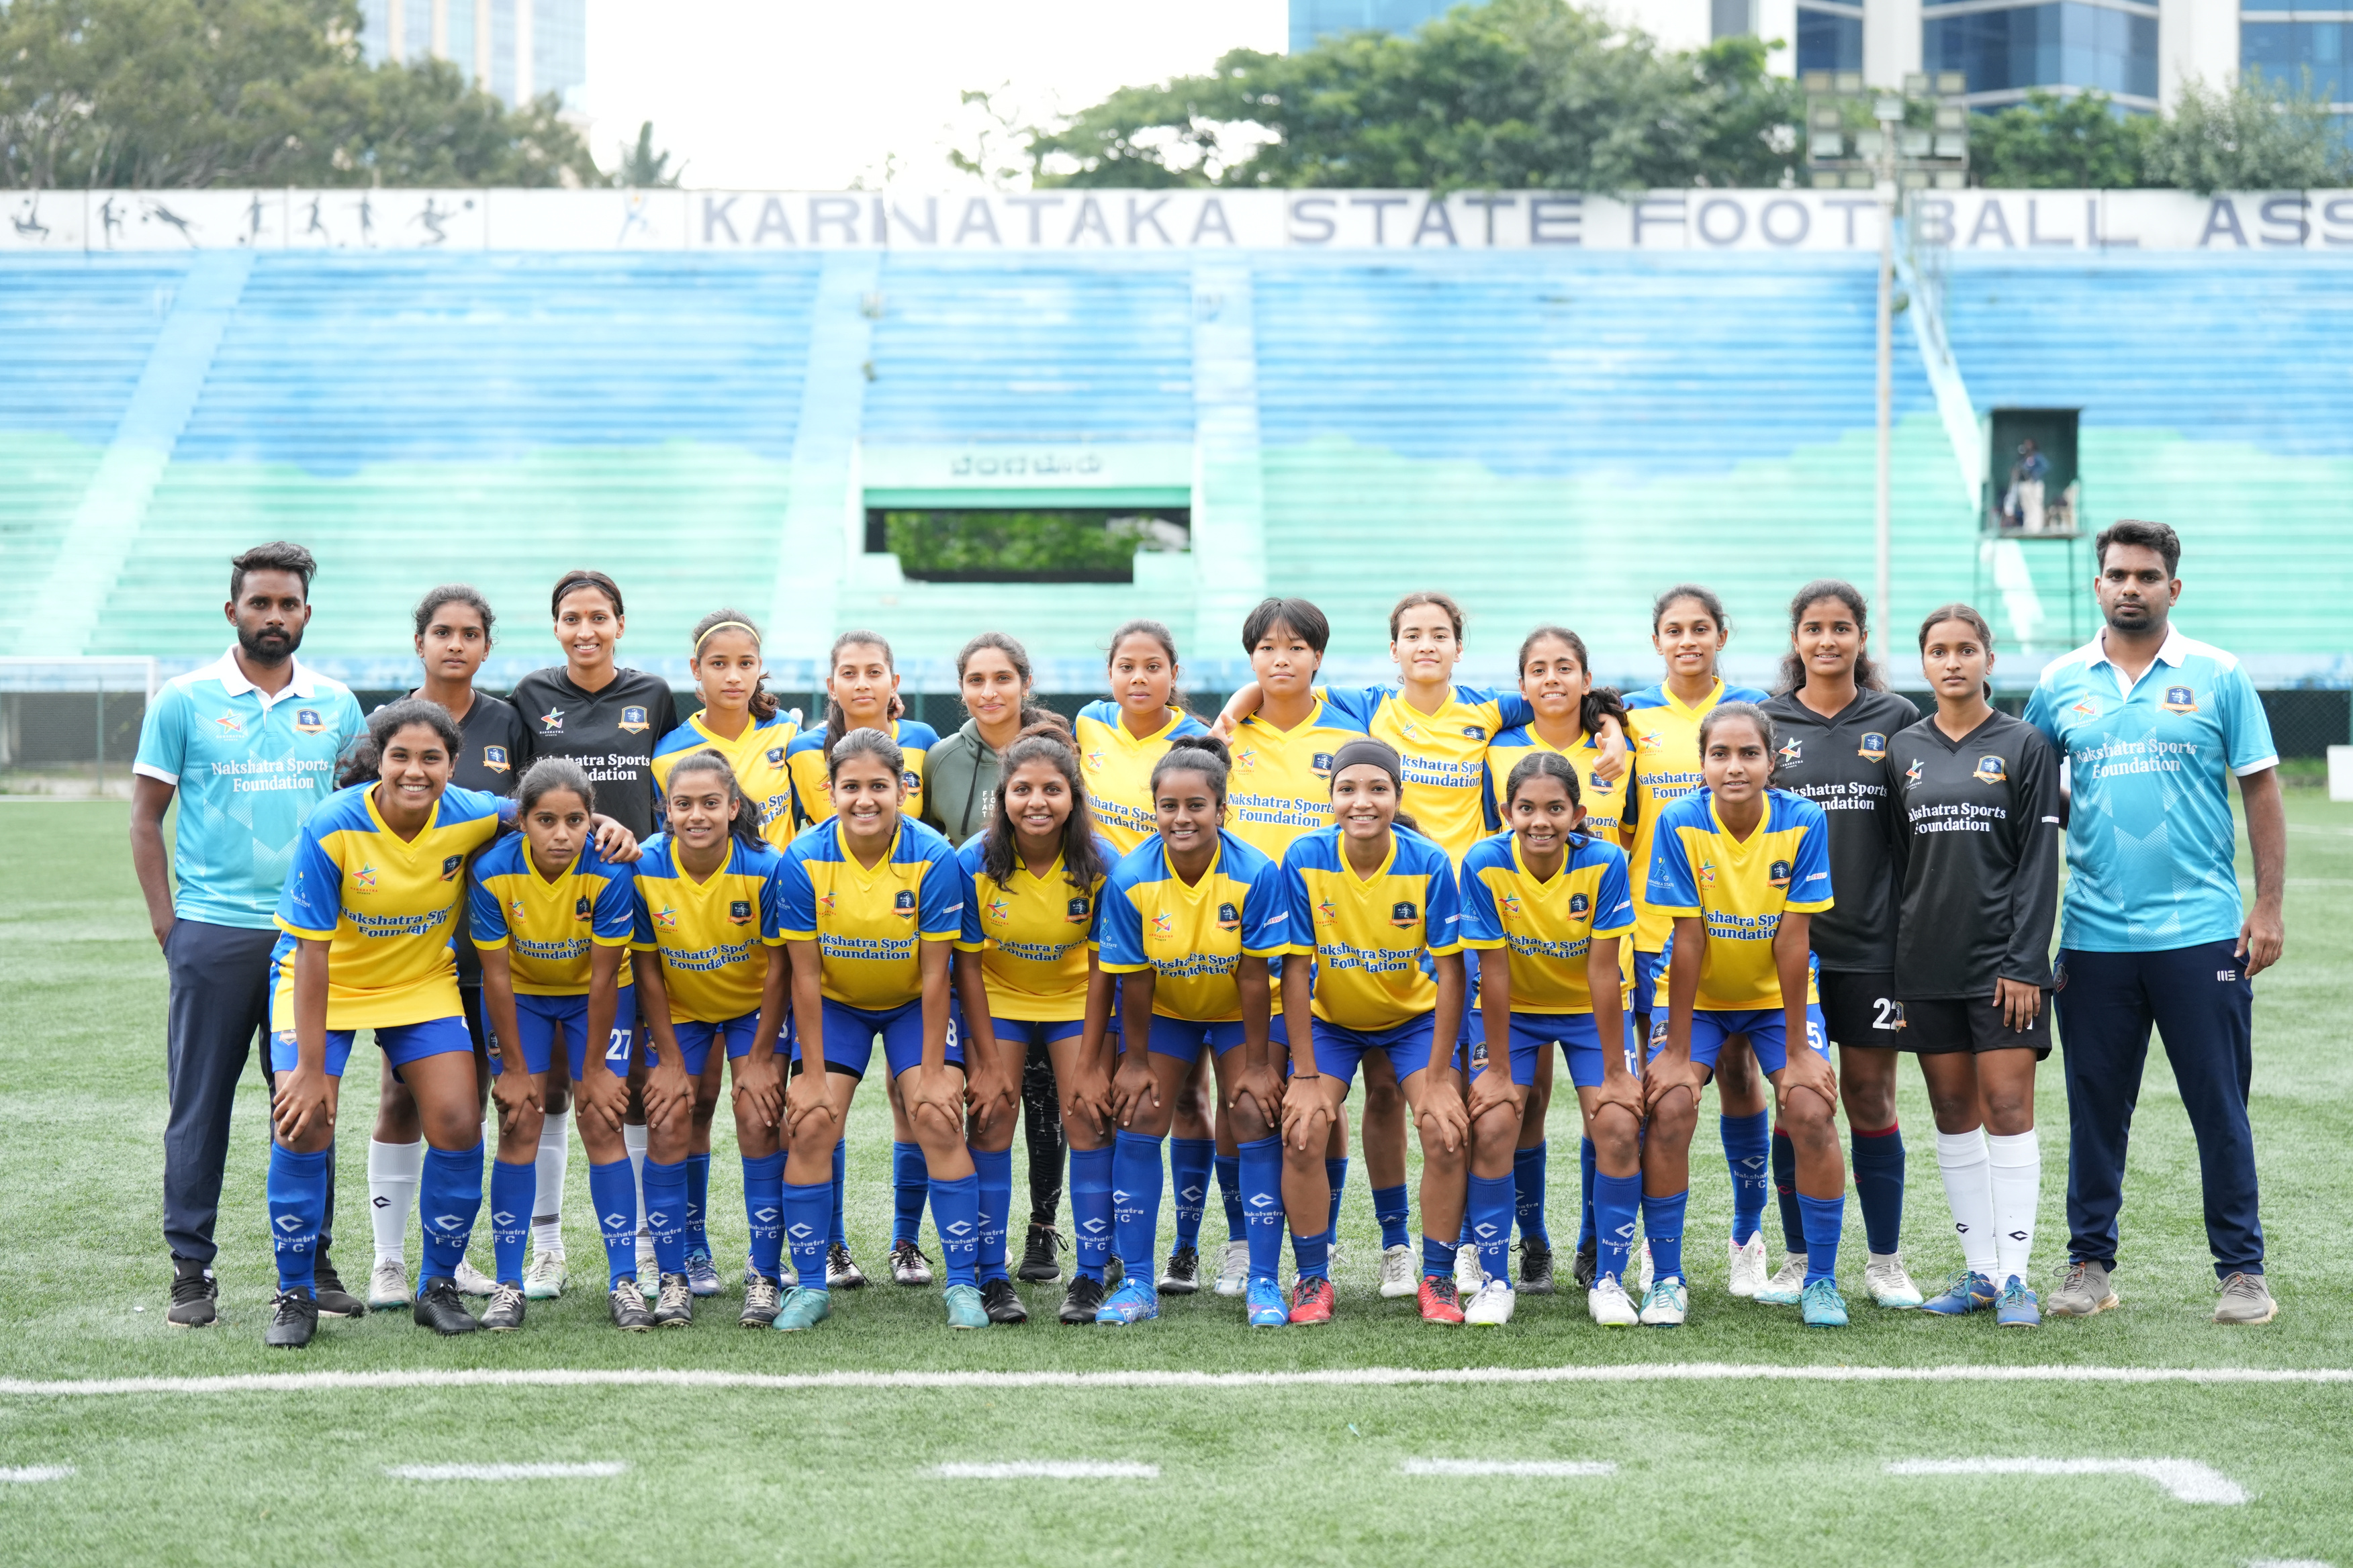

UNITED FC
KODAGU
OWN BY NAKSHATRA SPORTS
KARNATAKA SUPER DIVISION TEAM
EMPOWERING WOMEN THROUGH FOOTBALL

Slide 2
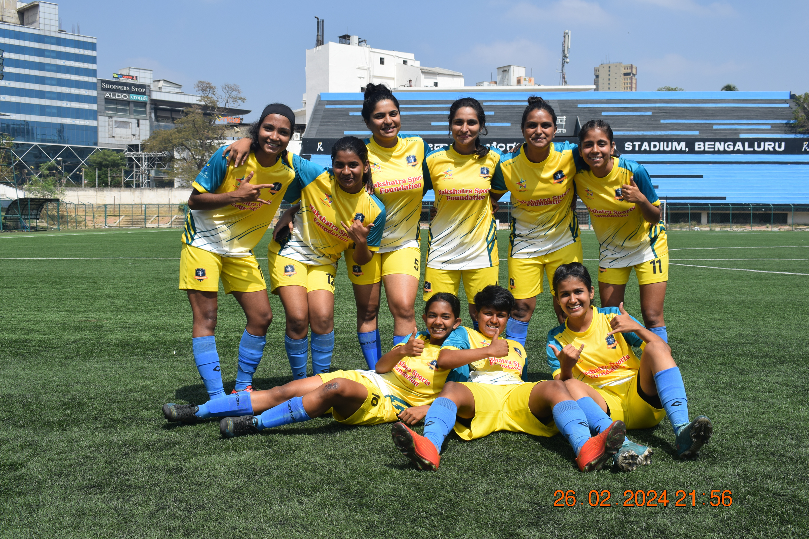

MISSION
Our mission is to empower young women through free, professional football training, fostering talent, discipline, and leadership. We are committed to building a strong platform for girls from all backgrounds to thrive in sport, gain exposure, and pursue their dreams with dignity and pride."
VISION
To create a world where every girl with a passion for football has the opportunity, resources, and support to rise, compete, and lead both on and off the field.

Slide 3
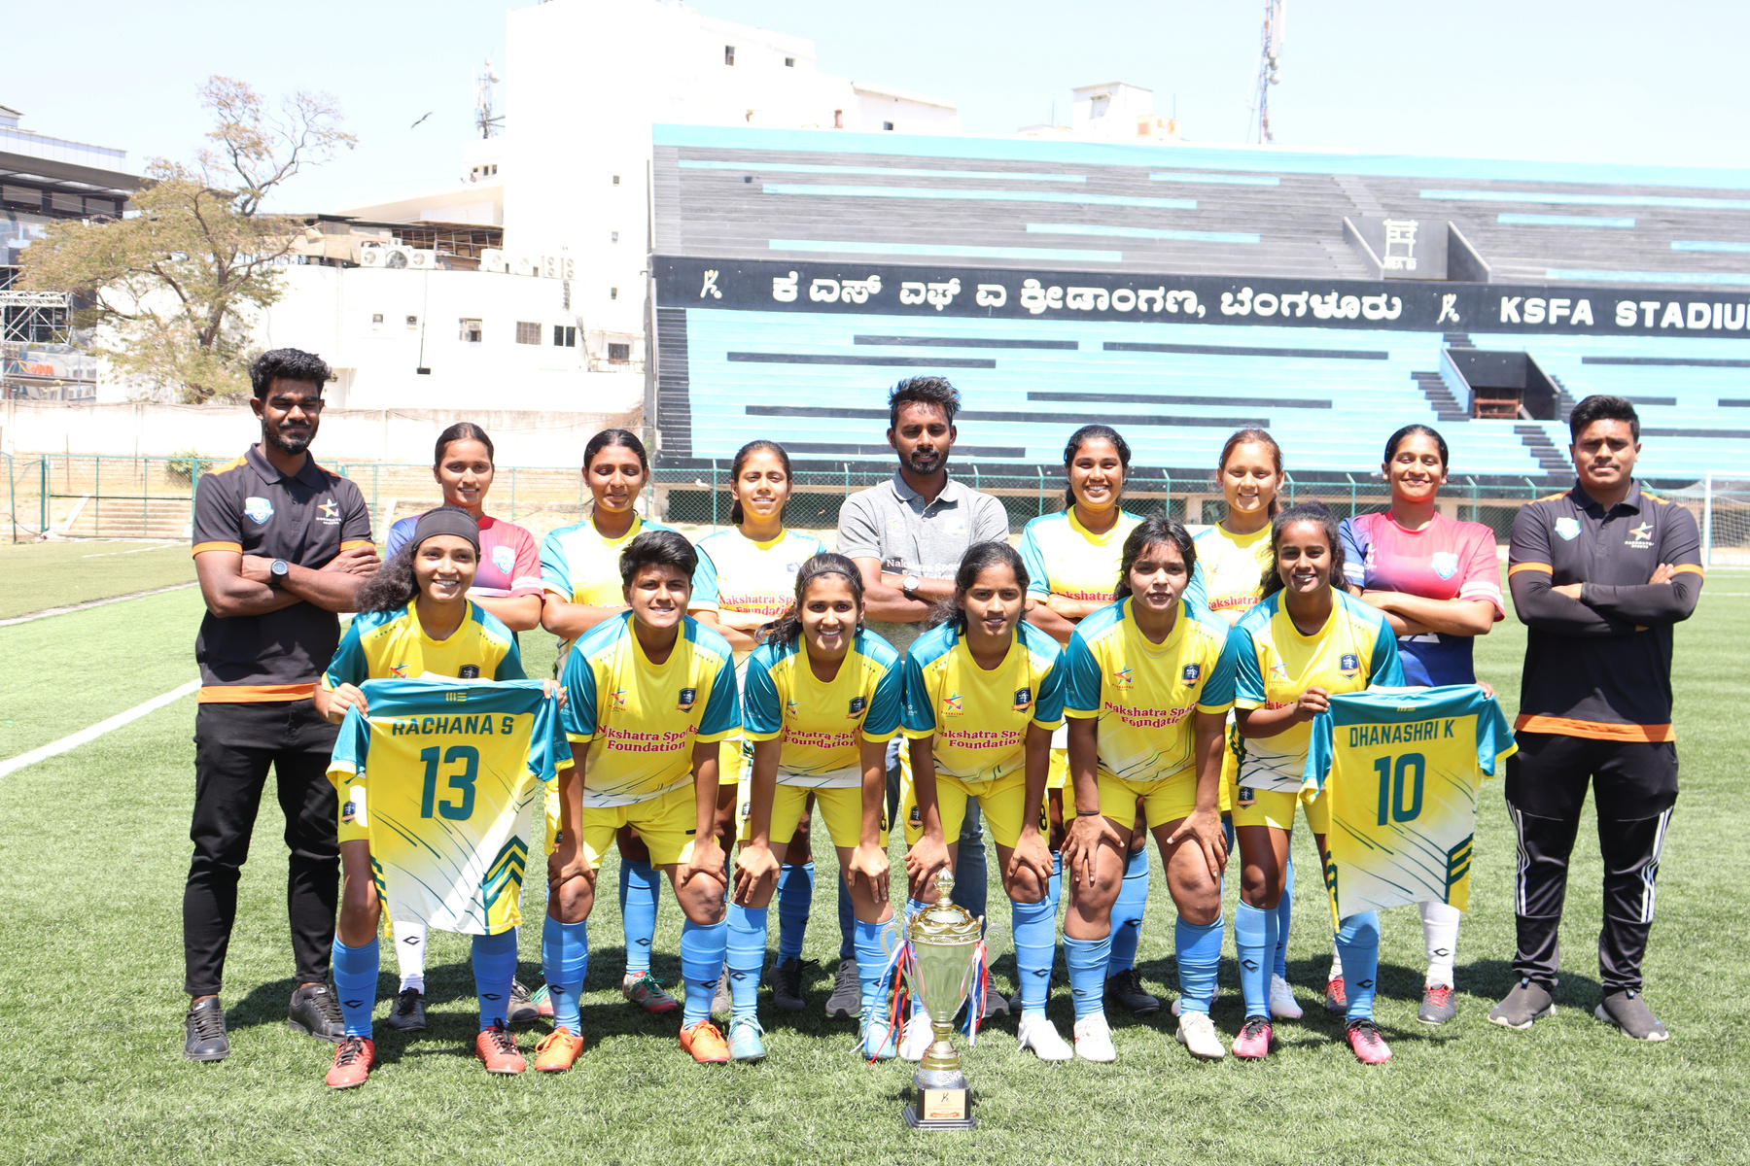




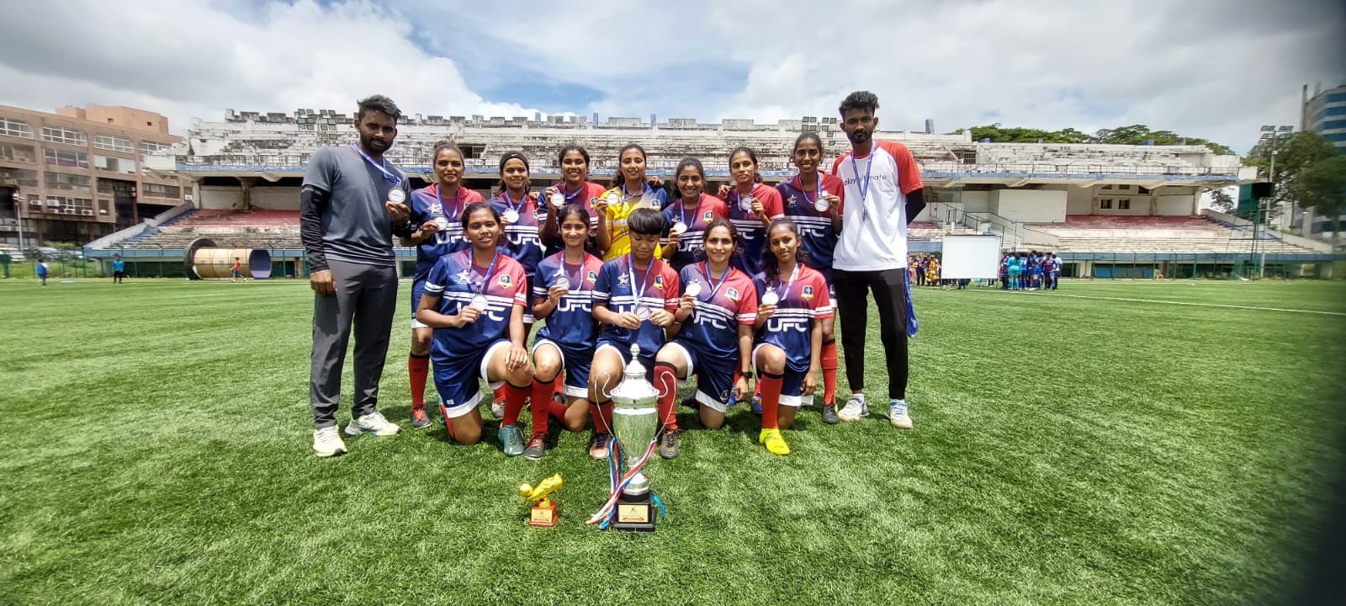



ACHIEMENTS & PROGRESS SO FAR
TABLE TOP WITHOUT A LOSS 2020-21
Finished as a table topper without single loss
We qualified to play in the Karnataka Womens A Division League
3RD UP-2021-22
secured 3rd position.
In Karnataka Women's A Division League
RUNNER UP-2022-2023
In Karnataka Women's A Division League we have placed second in Points table
CHAMPIONS - 2023-24
Secured top position in Karnataka Women's A Division League and qualified to play in Karnataka Women's Super division League
7TH POSITION IN THE KWL - 2024-25
Secured 7th position in Karnataka Women's Super division League.
In spite of the first time we played in the top league, our strategy was to not be de-promoted.
BUILINDING 2025-26
We are expecting to qualify into the "India Women's premier league"

Slide 4
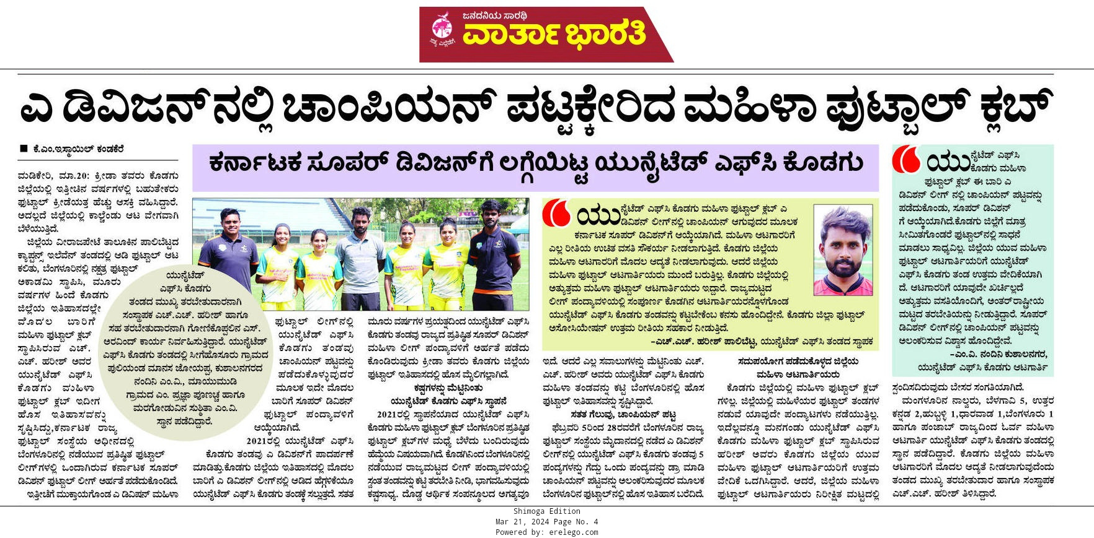
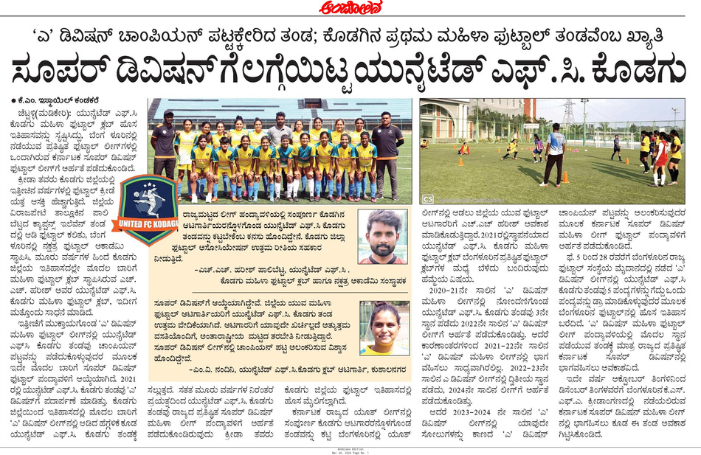
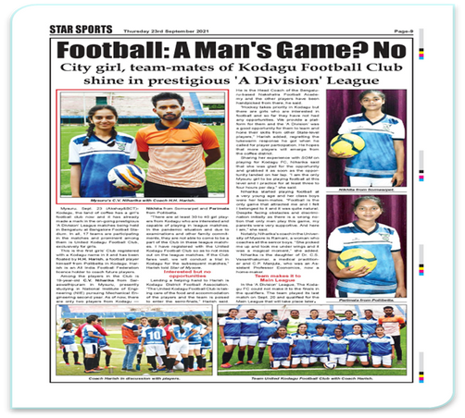
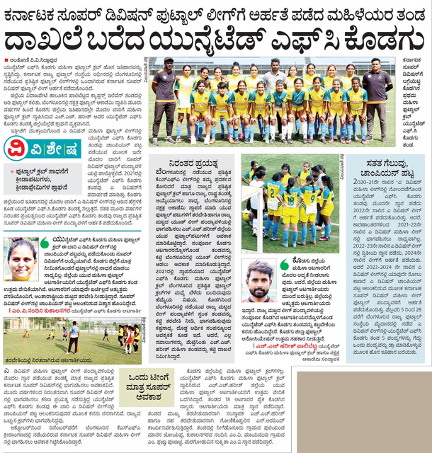
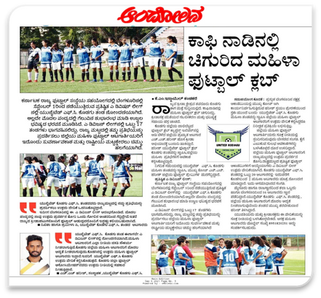
MEDIA COVERAGE

Slide 5
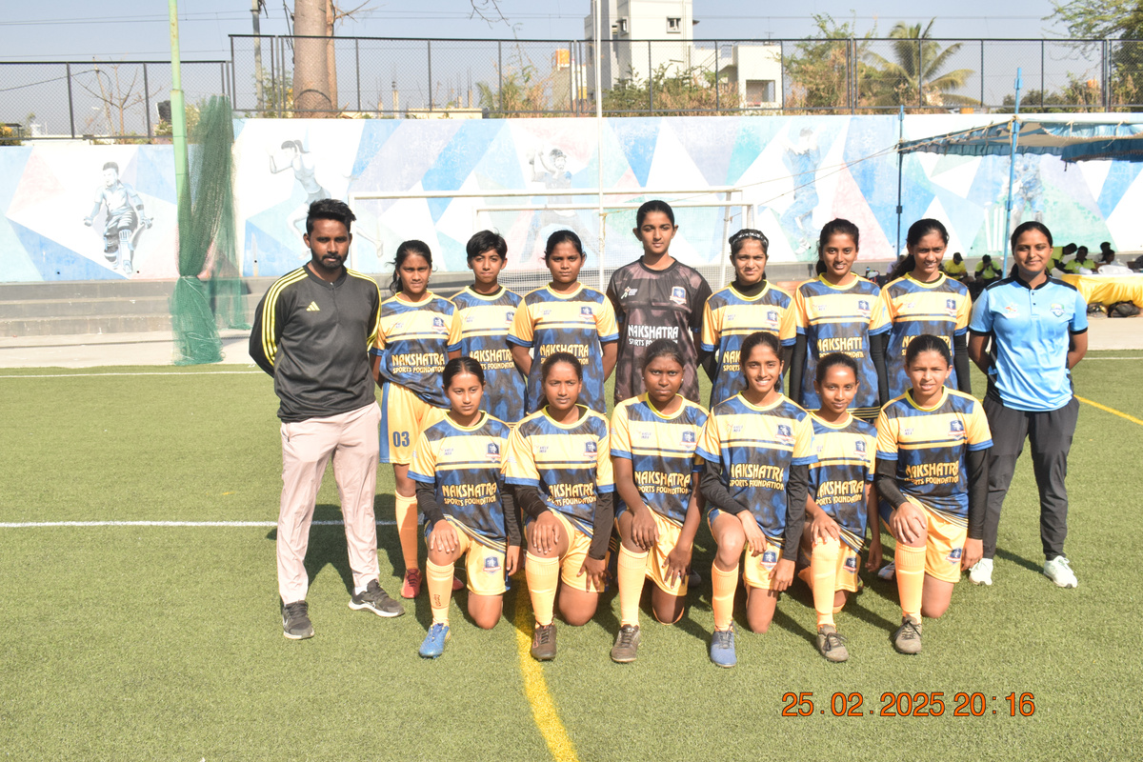
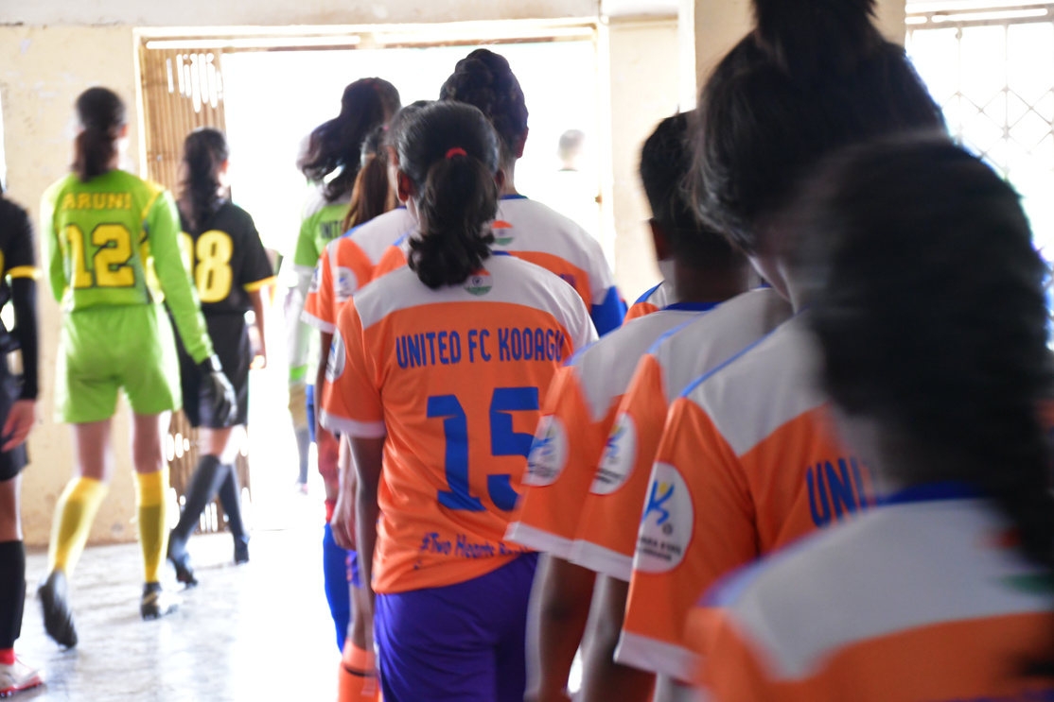
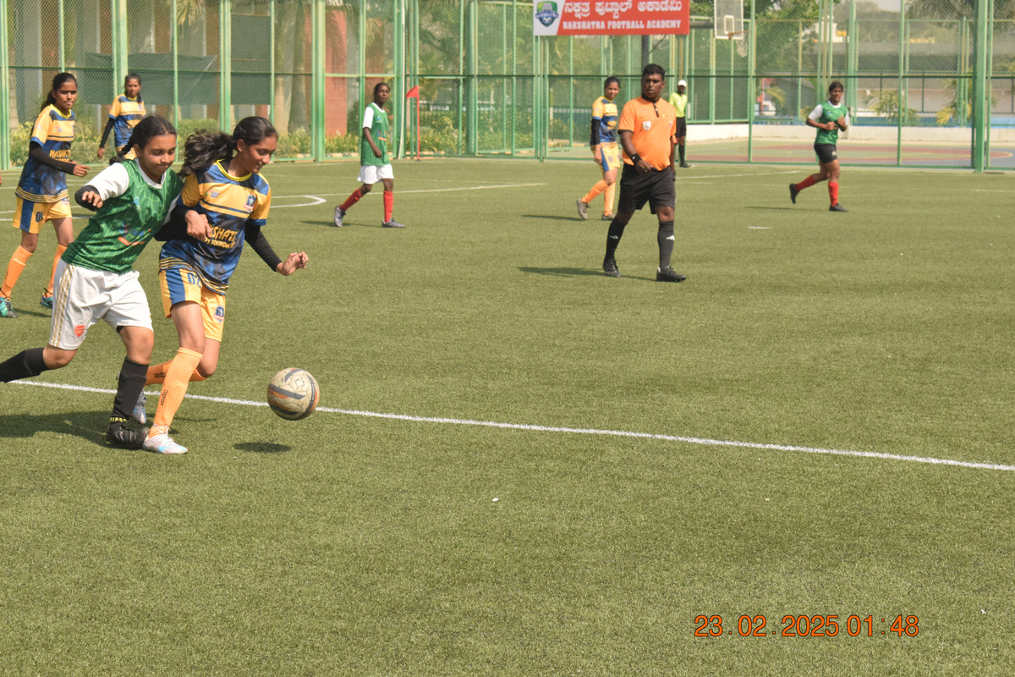
YOUTH SOCCER
PROGRAMS
Youth soccer programs play a pivotal role in shaping the next generation of players. These initiatives focus on skill development, teamwork, and instilling a lifelong love for the sport.
LONG-TERM DEVELOPMENT
Pathway to state, national teams, or IWL clubs
Career guidance in sports (coaching, refereeing, management)
Alumni support network and player tracking
TRAINING COMPONENTS
EDUCATION & SUPPORT
Weekly skill-based sessions (dribbling, passing,
shooting, positioning)
Tactical awareness and team play
Physical fitness and injury prevention
Mental health and confidence-building sessions
Academic support for players balancing school and sports
Workshops on nutrition, hygiene, and leadership
Scholarships and sponsorships for deserving students
COMMUNITY IMPACT
COACHING & MENTORSHIP
Promotes girls’ participation in sports in conservative or rural areas
Builds future role models and community leaders
Encourages inclusivity and social change through sport
Certified female and male coaches
Mentorship by senior women footballers
Workshops with professional athletes
FACILITIES & SAFETY
COMPETITIONS & EXPOSURE
Safe, child-friendly training environments
Quality equipment and regular medical checkups
Parental involvement and feedback channels
Friendly matches and inter-academy tournaments
Participation in district, state, and national-level leagues
Opportunities to join elite academies or clubs

Slide 6








FUTURE PLANS & GOALS
LAUNCH A RESIDENTIAL ACADEMY & SCHOLARSHIP
PROGRAM FOR TALENTED GIRLS
Partner with schools, clubs & sponsors
to expand reach across India
CREATE EMPLOYMENT & LEADERSHIP OPPORTUNITIES FOR WOMEN IN COACHING, REFEREEING, AND SPORTS MANAGEMENT
EXPANDING TO MORE DISTRICTS, WE ARE COMMITTED TO BUILDING A DEDICATED COACHING CAMPUS EXCLUSIVELY FOR WOMEN A PLACE WHERE PASSION MEETS OPPORTUNITY & DREAMS TURN INTO CAREERS.
BUILDING INFRASTRUCTURE SAFE, PROFESSIONAL-GRADE FIELDS WHERE WOMEN CAN TRAIN WITH DIGNITY AND CONSISTENCY.
Host talent identification camps, coaching
woRKSHOPS, AND TOURNAMENTS
Added benefits : ➢ Insurance for all the players and college fees
FUTURE LEAGUE AND TOURNAMENTS
STATE LEAGUES
NATIONAL LEAGUES
INTERNATIONAL LEAGUES
EUROPE LEAGUES
KARNATAKA WOMENS LEAGUE
UNDER 15 GIRLS KHELO INDIA LEAGUE
KARNATAKA A, B & C DIVISION LEAGUE
TAL LEAGUE
TCL LEAGUE
INDIAN WOMENS LEAGUE
IWL - 1
IWL - 2
AFC WOMENS CLUB CHAMPIONSHIP
WOMENS CLUB CHAMPIONS LEAGUE
WOMENS CLUB WORLD CUP LEAGUE

Slide 7
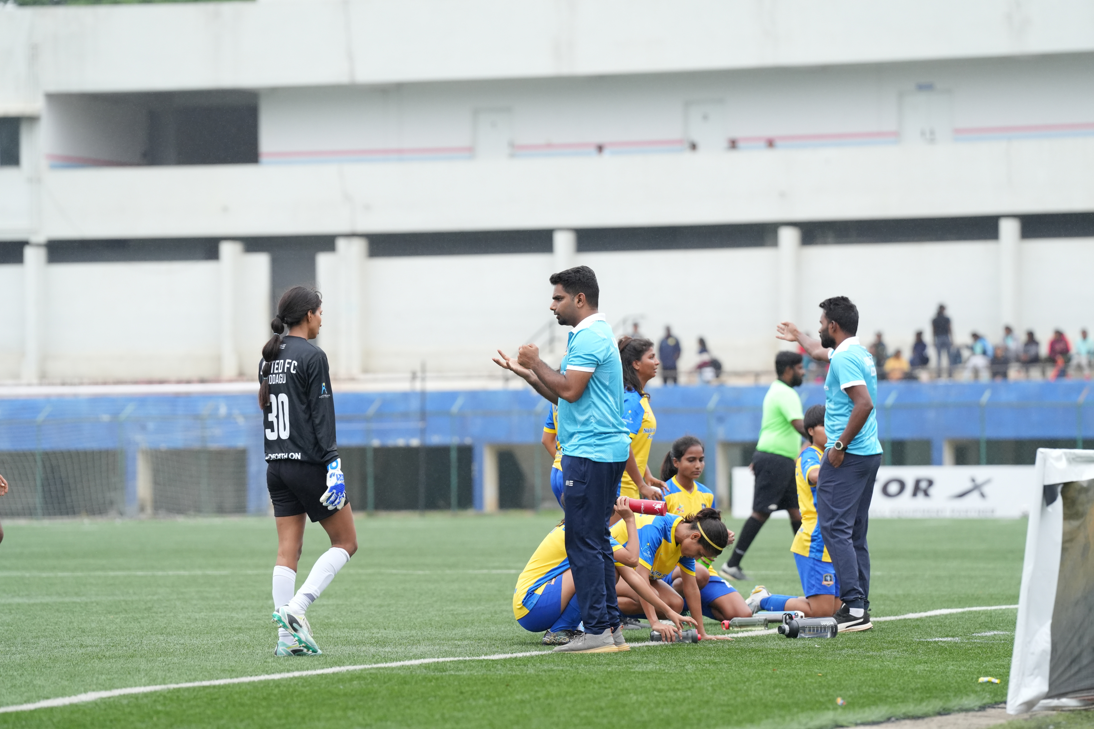
WHAT WE NEED ?..
HEALTH SUPPORT
TRAINING EXPENSES
ACCOMMODATION
FOOD
PHYSIOTHERAPY FOR THE PLAYERS
MEDICAL SUPPORT
ACADEMIC STRESS
MENTAL HEALTH
COUNSELING
PLAYERS INSURANCE
GROUND FEES
TRAINING EQUIPMENTS
SWIMMING RECOVERY SESSION
GYM SESSION
STRENGTH & CONDITION
PLAYERS STAYING
COACHES STAY
STAFFS STAY
NUTRITION FOOD FOR PLAYERS AND COACHES
FRUITS DURING THE MATCHES
SNACKS
MATCH & TRAINING JERSEYS
COACHES SALARIES
EDUCATION SUPPORT
TRAVEL
LEAGUE MATCHES JERSEYS
TRAINING JERSEYS
PLAYERS TRAVELLING T SHIRTS
COACHES TRAINING AND TRAVELLING TSHIRTS
COACHES SALARY
STAFFS SALARY
ACADEMIC FLEXIBILITY
SCHOOL & COLLEGE FESS
STUDY MATERIALS
EXAM FEES
MATCH AND TRAINING TRAVELLING ARRANGMENTS
PLAYERS TRAVELLING

Slide 8
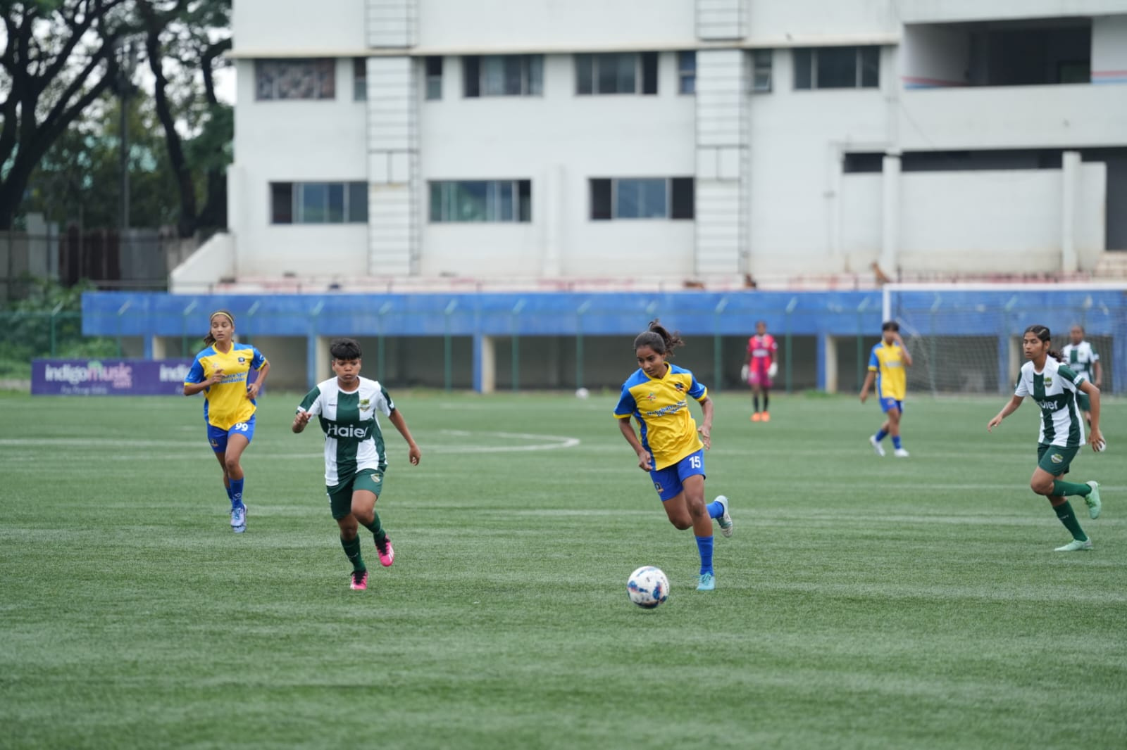
SPONSORSHIP BENEFITS..
BRANDING ON JERSEYS
SOCIAL MEDIA
EVENT & GROUND BRANDING
DIGITAL MEDIA PRESENCE
Sponsor Logo Placement on match kits, training kits, tracksuits.
Front, back, sleeve, or shorts placement based on package level (Gold, Silver, Bronze).
Constant visibility in matches, media, and social media
Brand exposure to your followers, improved engagement.
Will Tag & Mention sponsors in posts, stories, reels, highlights, during match promotions, player spotlights & training videos.
Weekly or monthly Sponsor Appreciation Post
Display sponsor banners, flags, hoardings at training grounds, matches, or events.
Use branded tents or media backdrops.
On-ground visibility to spectators, players, media.
Website mentions: sponsor logos on homepage, player profiles, and blog posts.
Newsletter branding: include sponsor banners or shoutouts in mailers.
Professional association and brand credibility.
COMMUNITY & CSR BRANDING
MEDIA COVERAGE & PR
CUSTOMIZED ACTIVATIONS
CO-BRANDED MERCHANDISE
Involve sponsor in social impact events free football camps, women empowerment initiatives, school visits.
Highlight sponsor contributions in CSR-related campaigns.
Benefits - Goodwill, CSR visibility, positive public image
Mentioning in press releases, interviews, and articles.
Include sponsor logos in media coverage, newsletters, and YouTube match uploads.
Benefits - Media reach and brand credibility.
Sponsor product sampling at matches or camps.
Offer sponsor booths at events or social activations (like fan zones).
Benefits - Direct customer interaction and lead generation.
Sell or distribute team merchandise (caps, bags, water bottles) with sponsor logo.
Host give aways on social media with sponsor-branded goodies.

Slide 9
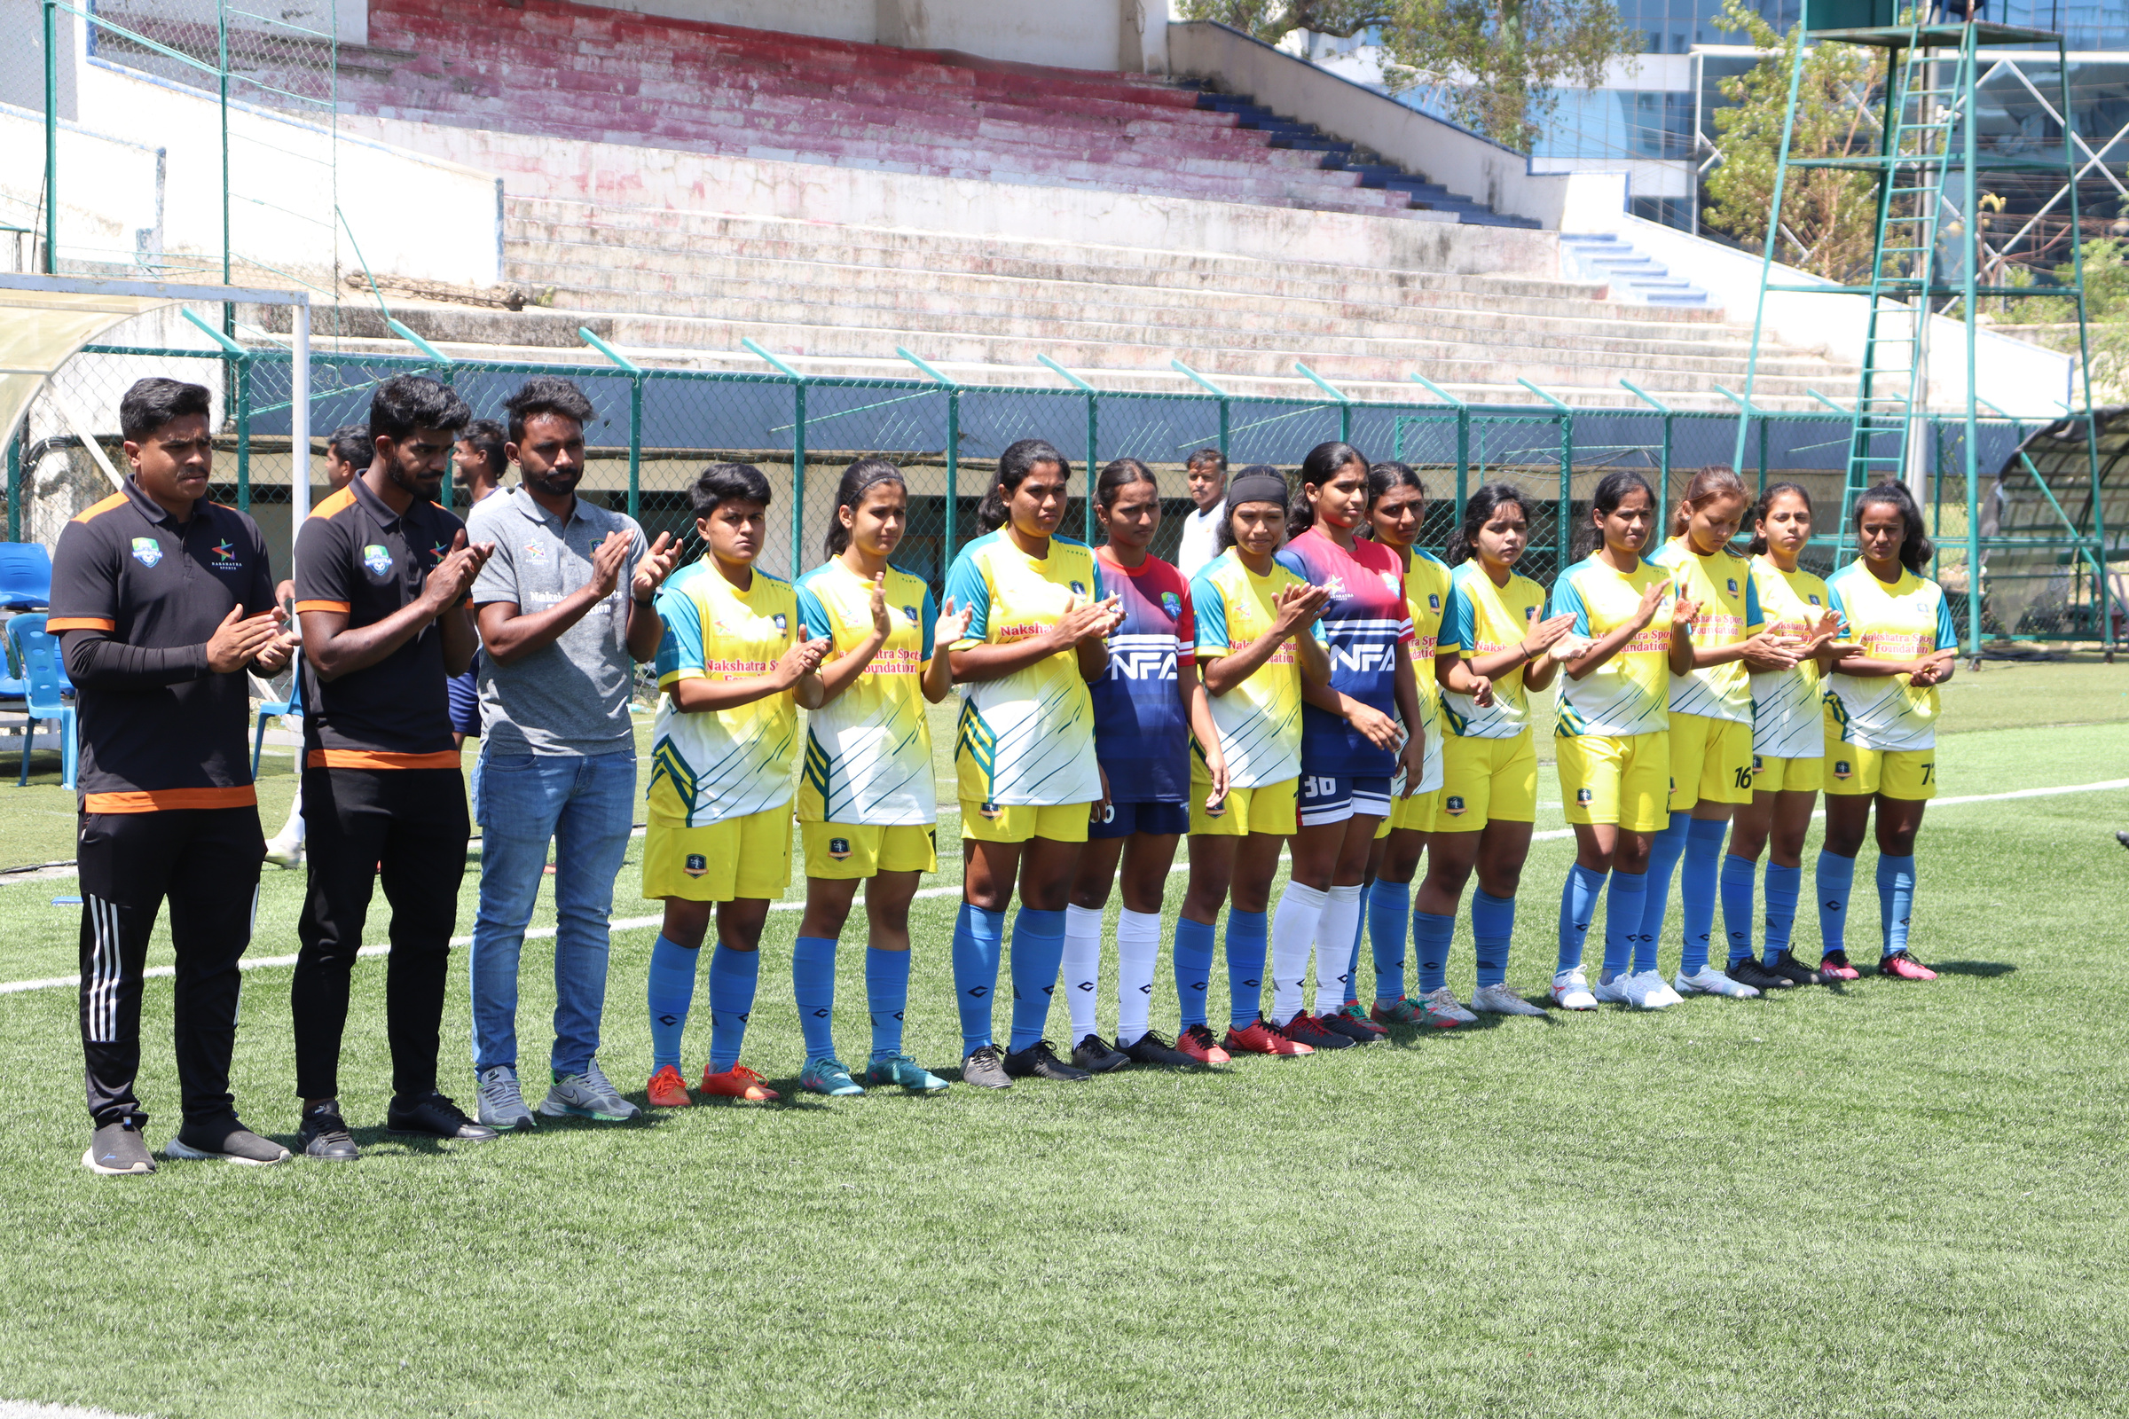
THANK YOU
FOR YOUR TIME!
Thank you for taking the time to explore the
dynamic and fascinating world of soccer.
Whether you're a player, fan, or new enthusiast,
soccer offers something for everyone.
CONTACT NUMBER +91 8951820251
PRESENTED BY - HARISH H
EMAIL - UNITEDFCKODAGU@GMAIL.COM
WWW.UNITEDFCKODAGU.COM

